Slide 1

Making Price Forecasting Of SUWEN Stock Using Machine Learning Techniques

Slide 2

Which Techniques Did We Use?
RNN
LSTM
MOVING AVERAGE
ARIMA

Slide 3
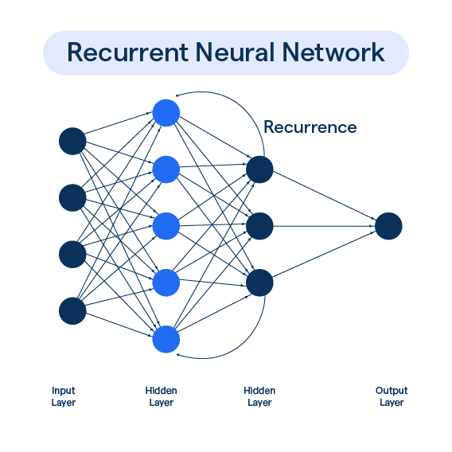
What Is RNN ? (Recurrent Neural Network)
They are specifically designed to work with ordinal data. Traditional neural networks can have difficulty processing sequential data because information from previous time steps of such data is often lost. RNNs are designed to solve this problem and can work more effectively with sequential data by retaining information from previous time steps.

Slide 4
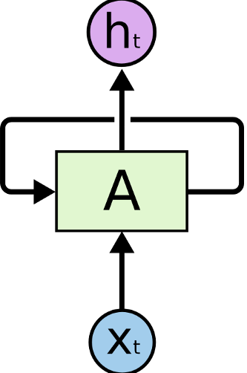
How does the Rnn technique work?
The basic structure of RNNs is as follows:
1-Recurrent Structure: RNNs have an internal loop that contains information from previous time steps. This ensures that the network can remember information from previous steps.
2-Inputs and Outputs: RNNs take an input series and produce an output series. For example, when building a language model, the input could be a sentence and the output could be the probabilities of one word or the next word.
3-Parameter Sharing: RNNs share parameters by using the same network repeatedly. That is, the weights and parameters learned while training the network are the same across all time steps.

Slide 5

How did we use the Rnn method in our project?
Let's examine how we use it with its codes;

Slide 6
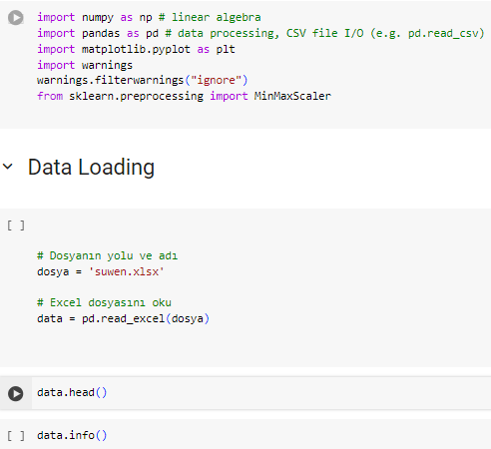
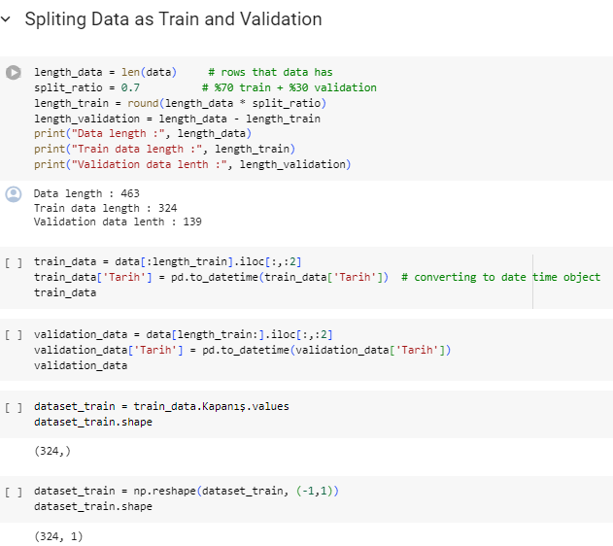
1 -
As a first step, we started by preparing the libraries and data sets we will use.

Slide 7

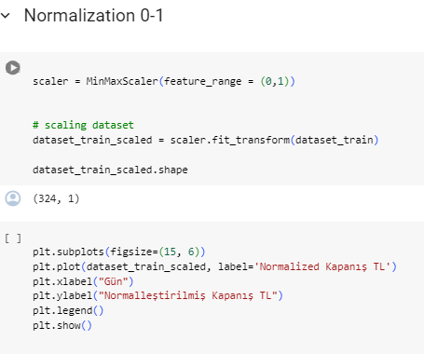
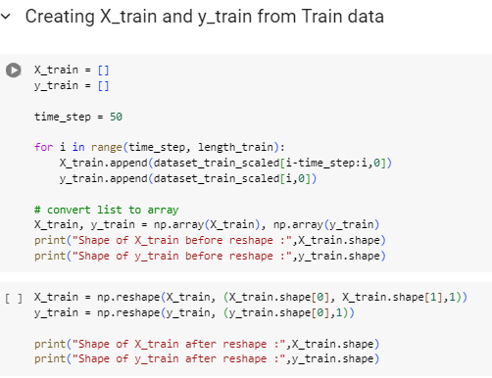
2
As a second step, we normalized all the features and brought them to a certain range. So we helped it perform better.
3- As step 3, we defined our training and test data.

Slide 8
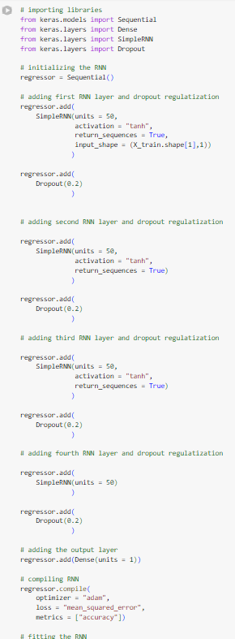
In step 4, we adapted the Rnn method to our code and added layers to enable price prediction.

Slide 9

Now let's examine the outputs of the graphs we created using the RNN method;

Slide 10
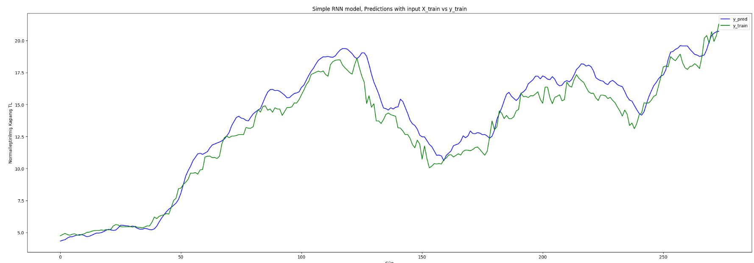

Slide 11
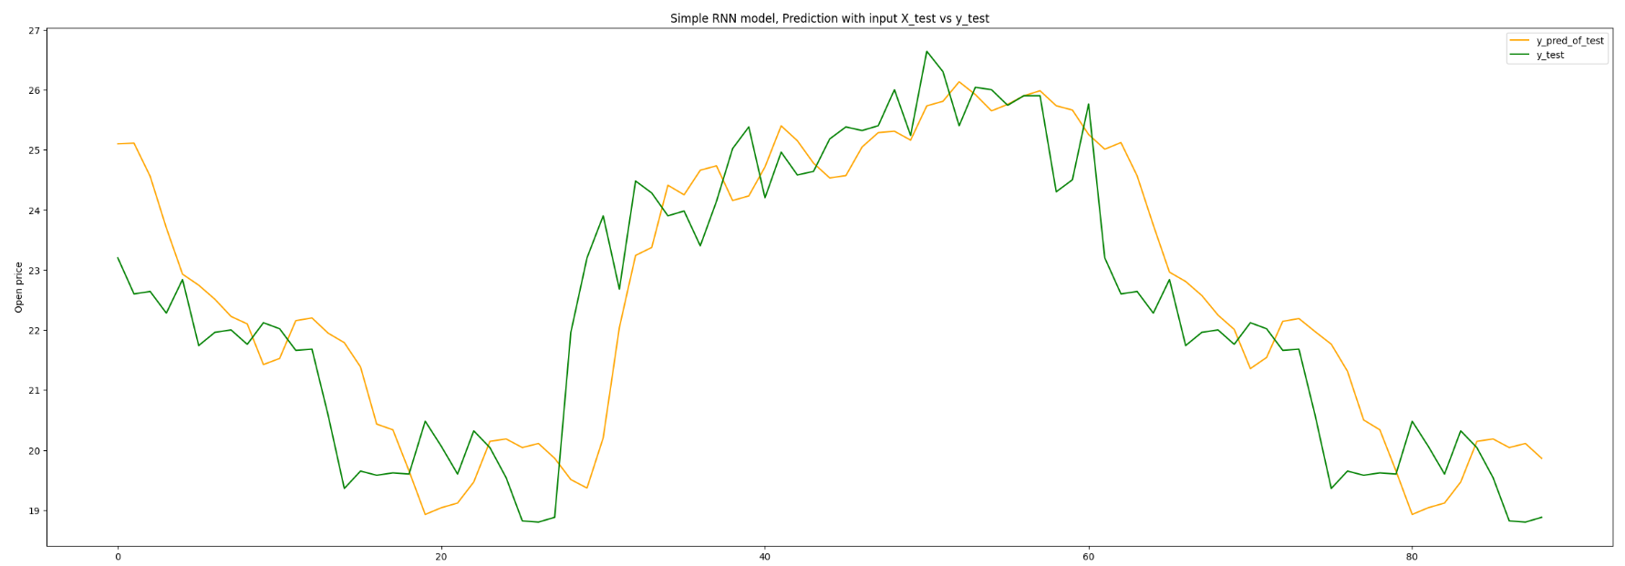

Slide 12
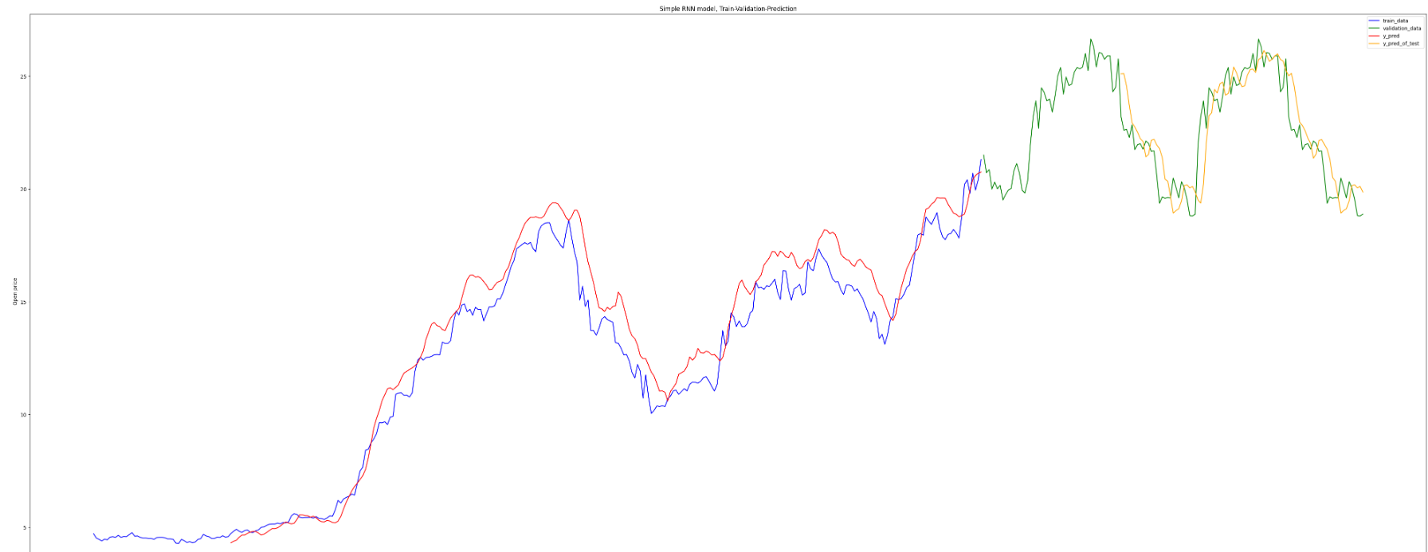

Slide 13
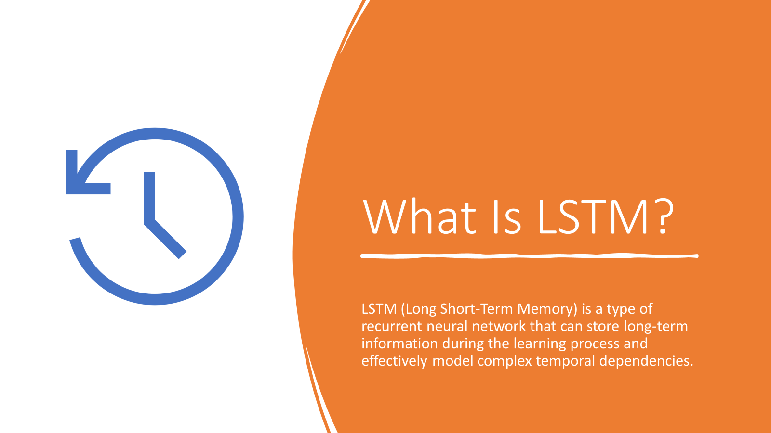

Slide 14
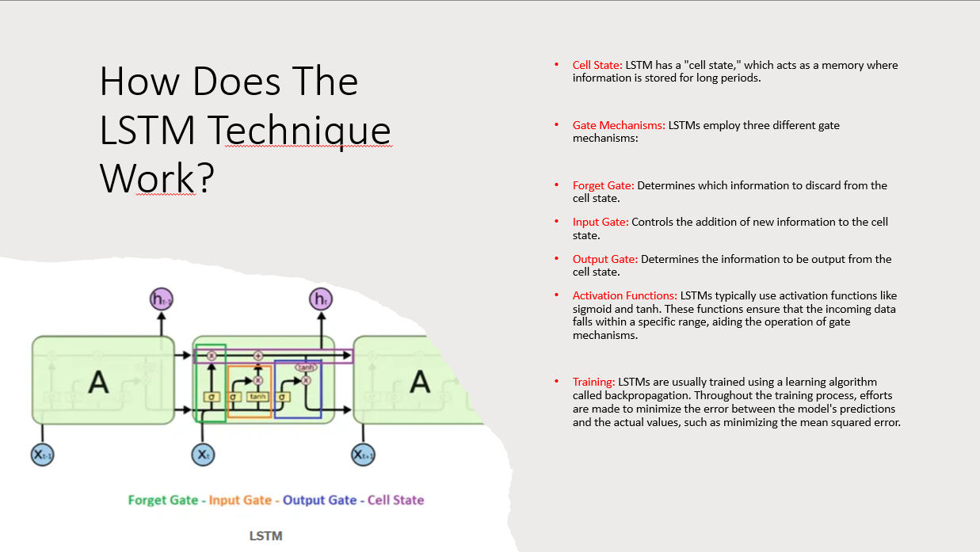

Slide 15
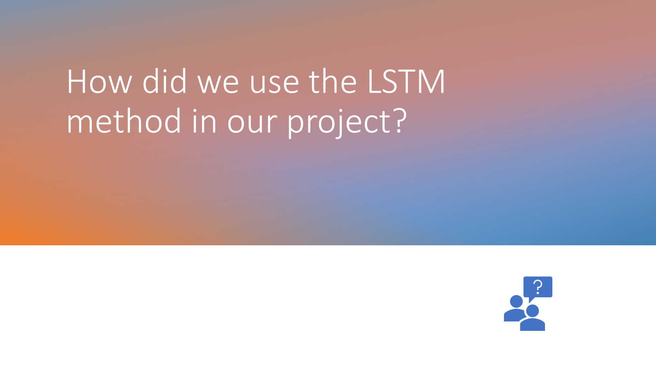

Slide 16
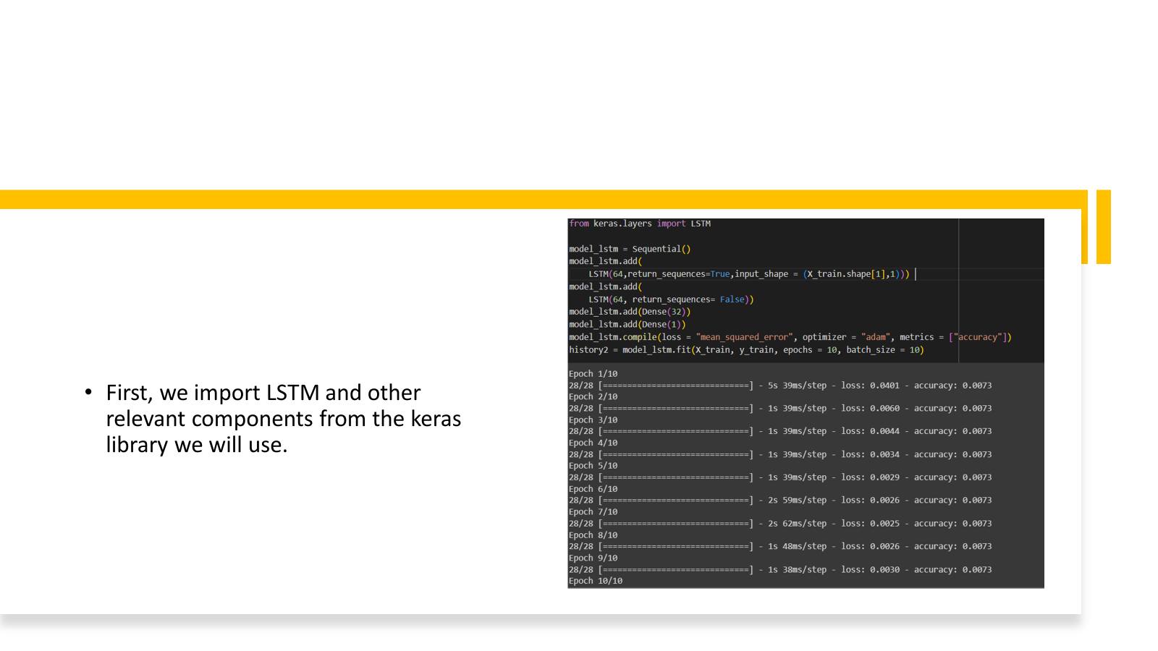

Slide 17
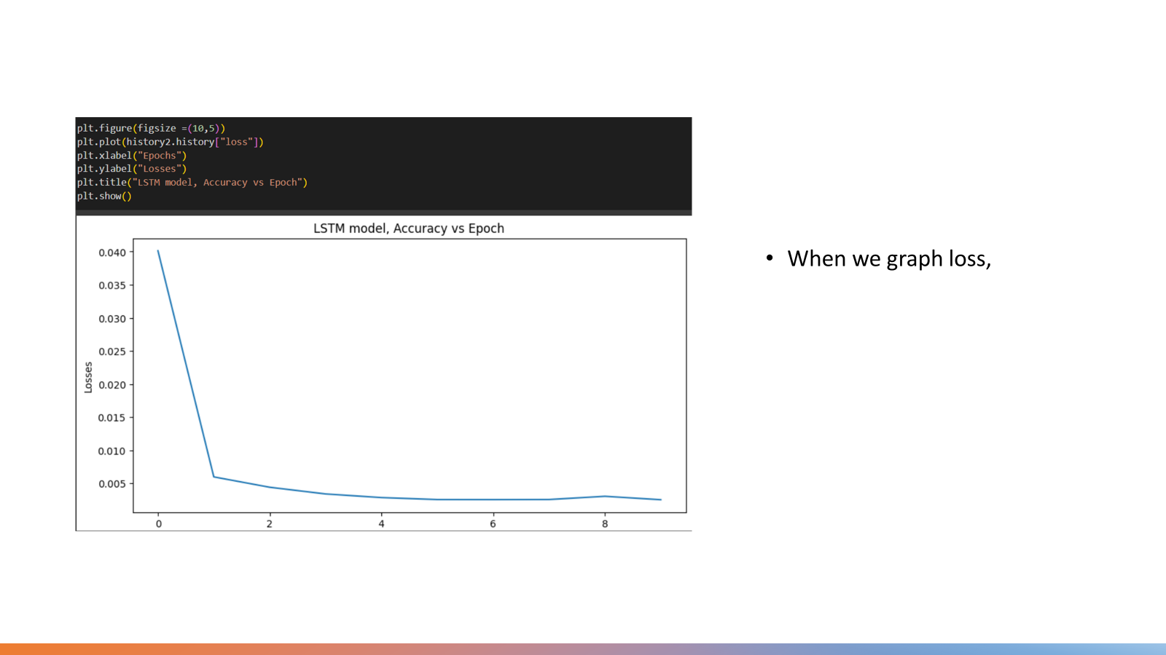

Slide 18
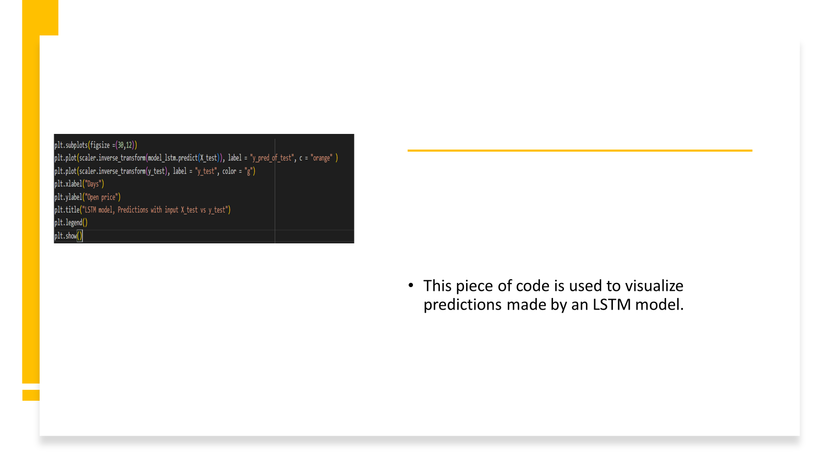

Slide 19
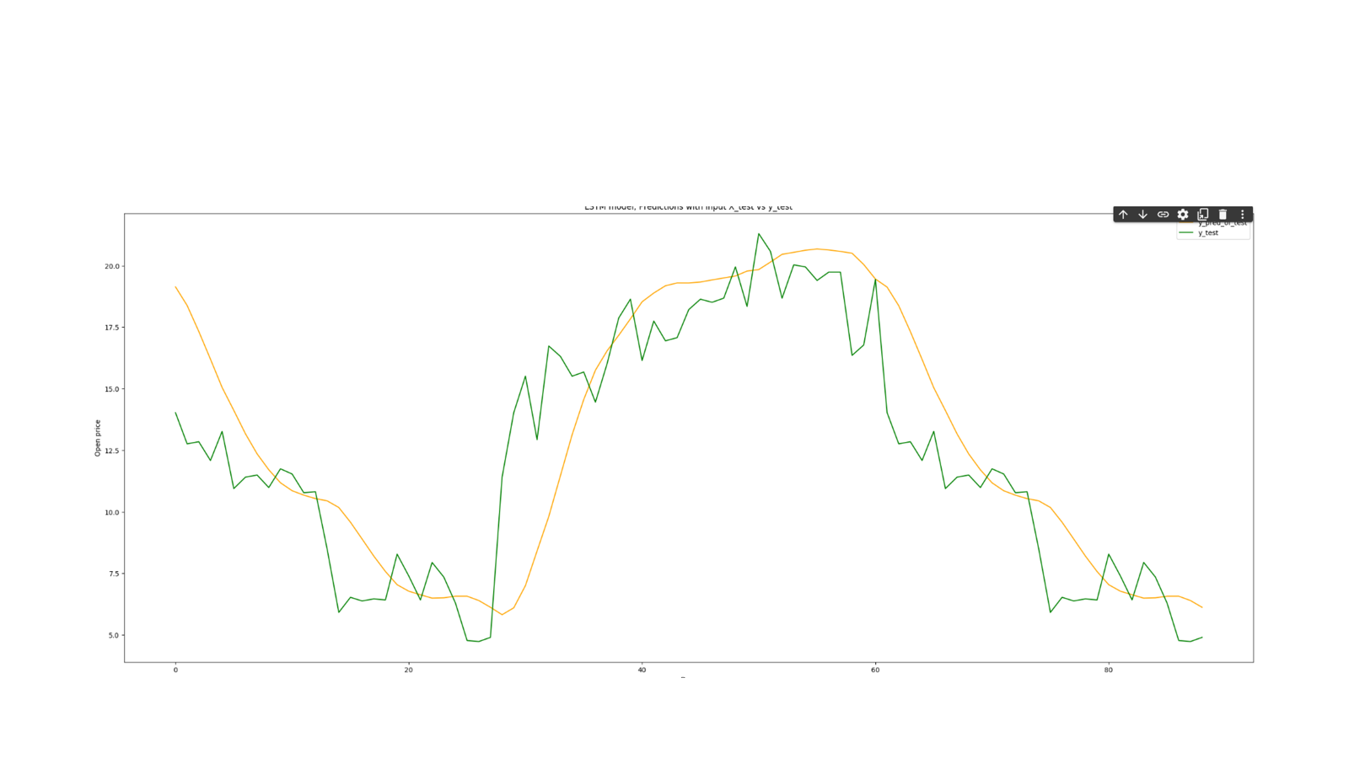

Slide 20
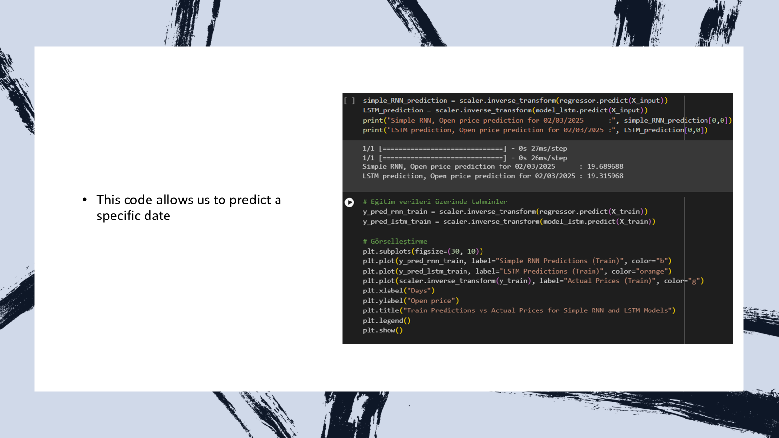

Slide 21
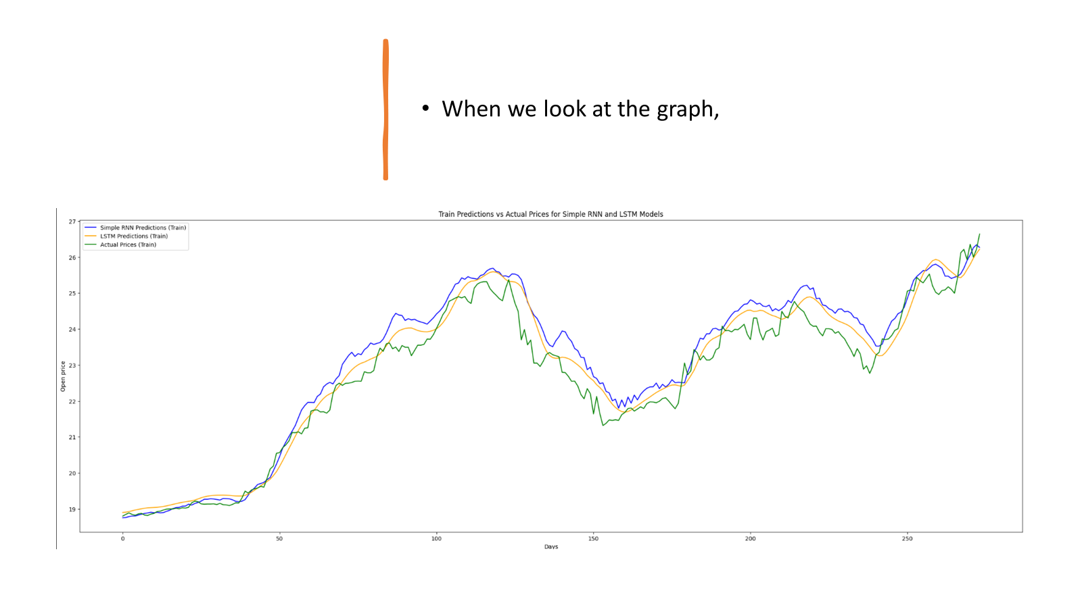

Slide 22


Slide 23
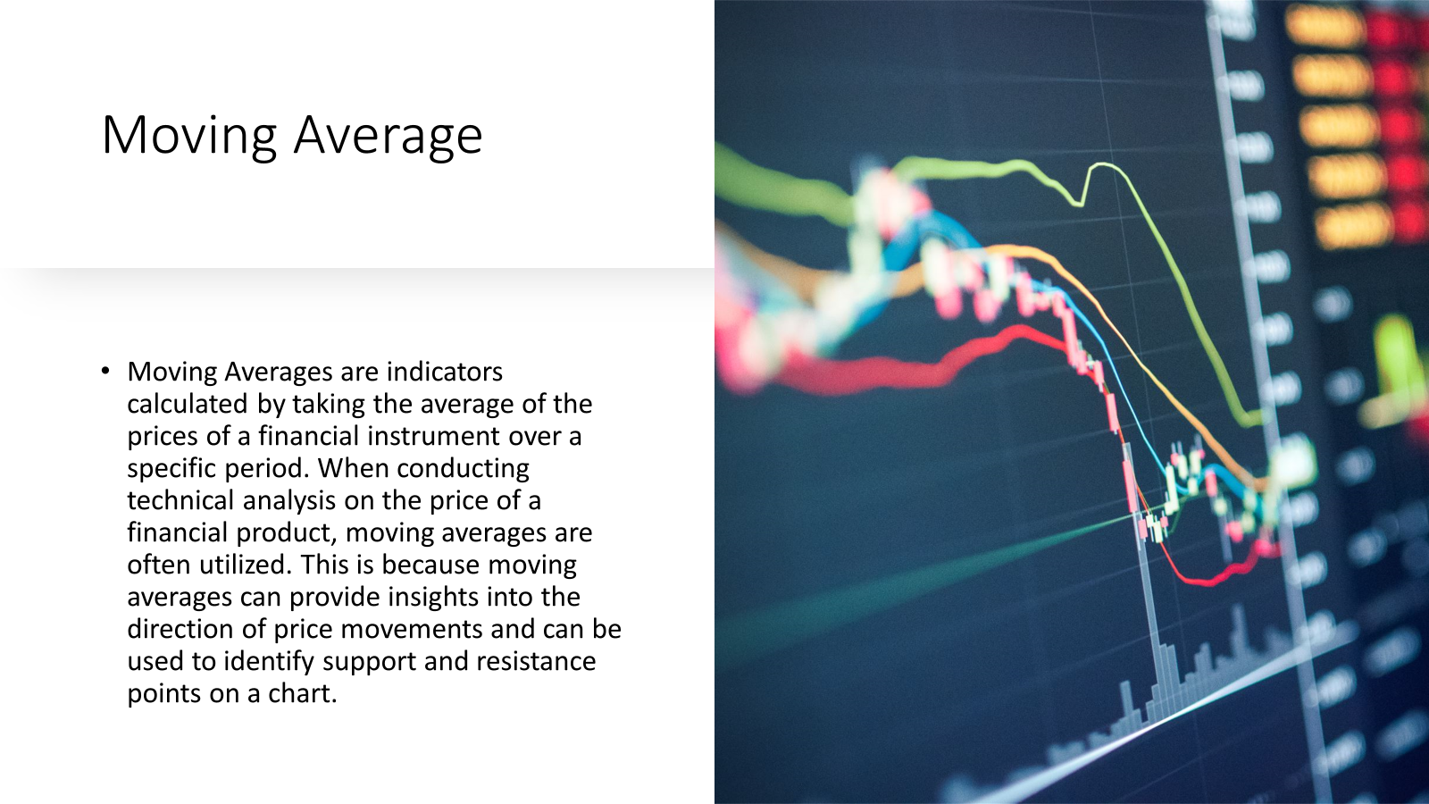

Slide 24
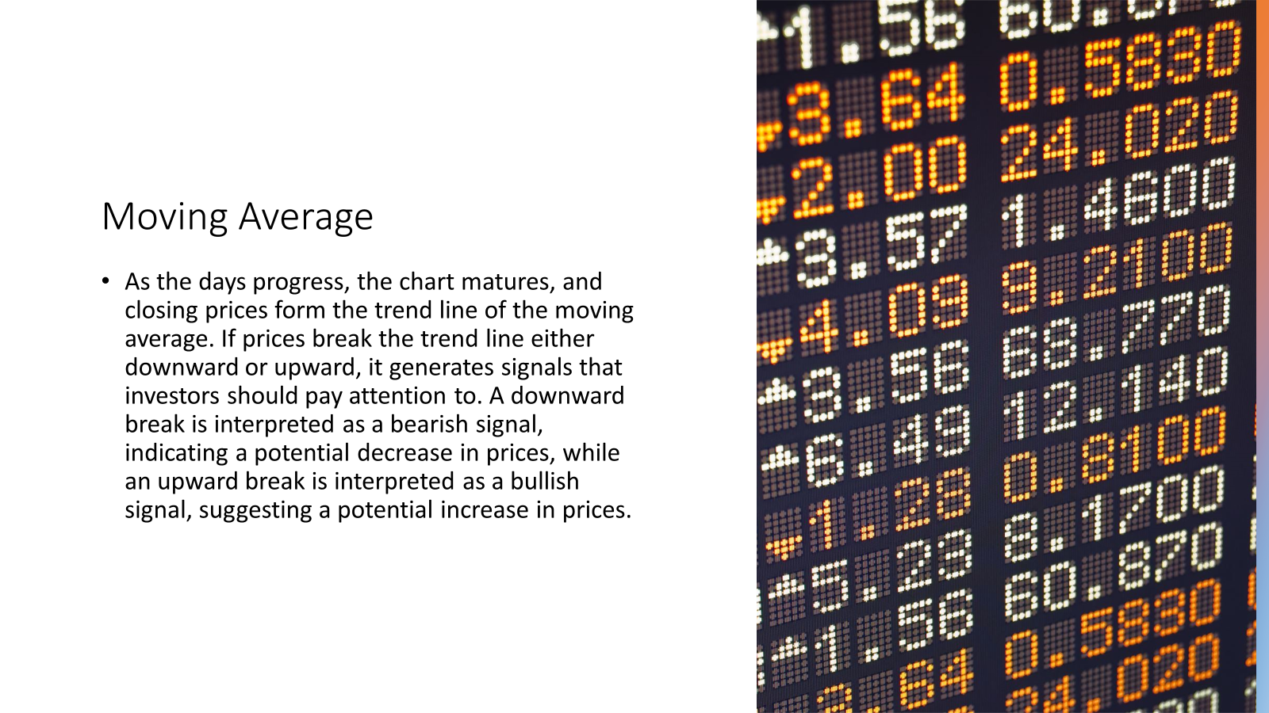

Slide 25
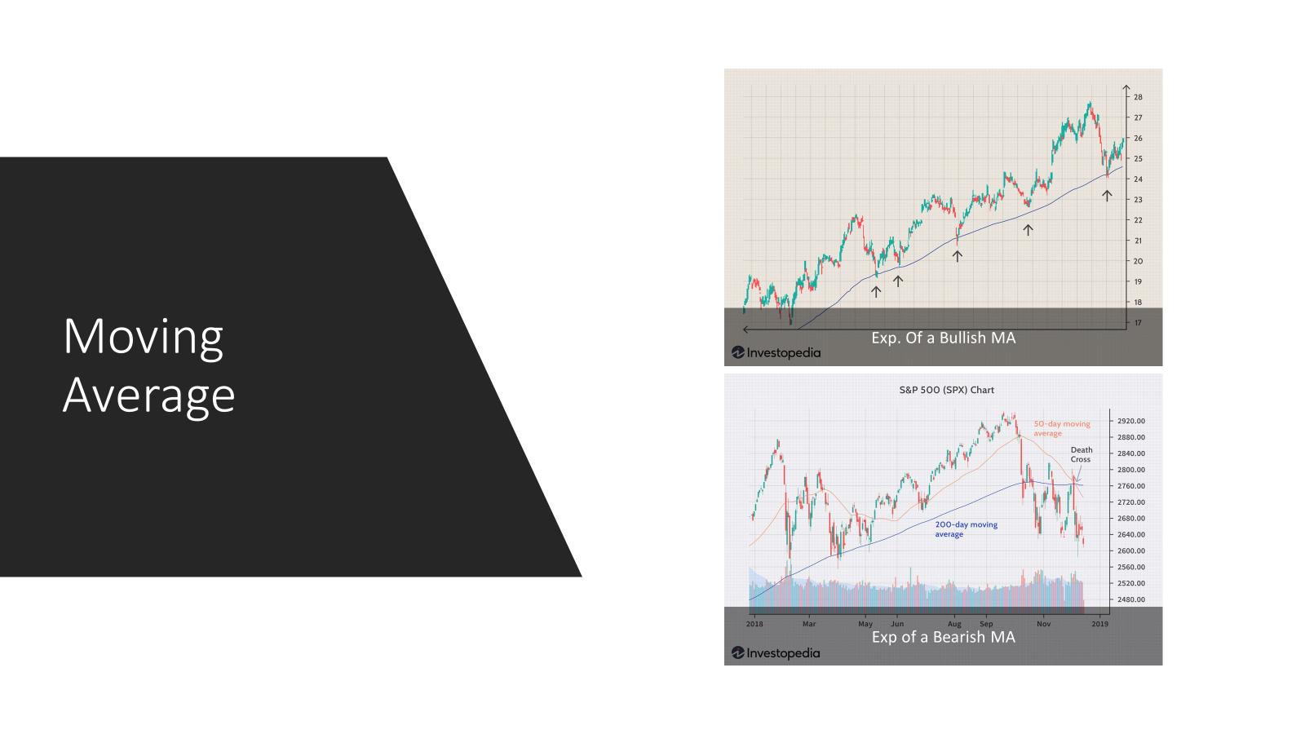

Slide 26
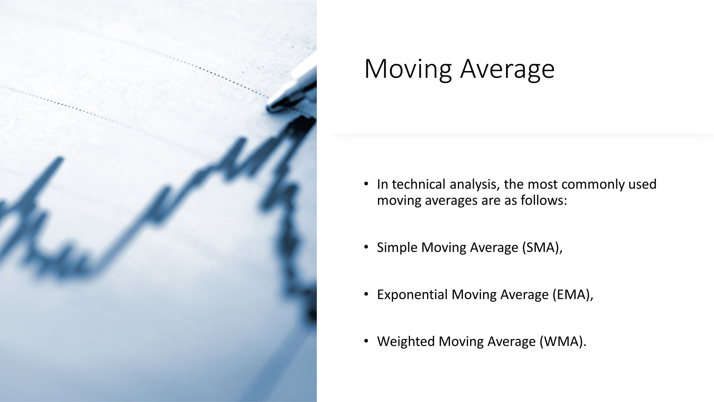

Slide 27
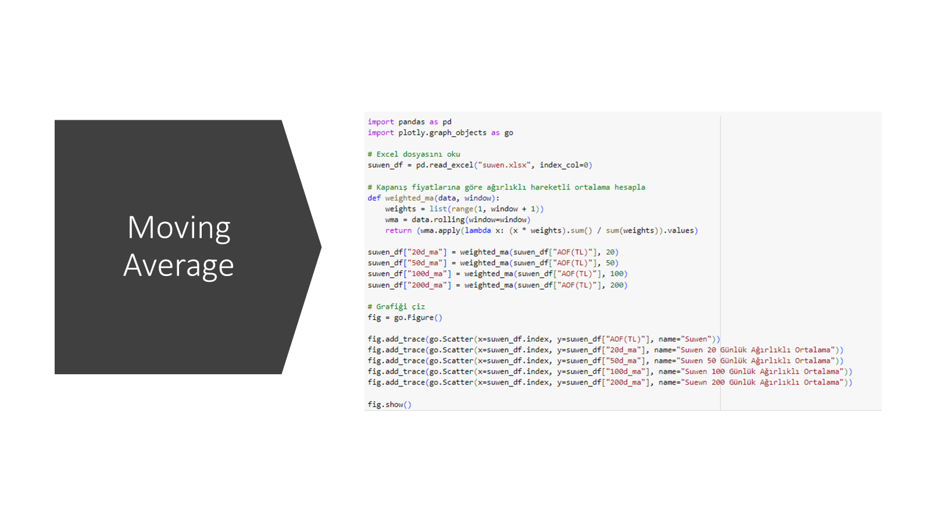

Slide 28
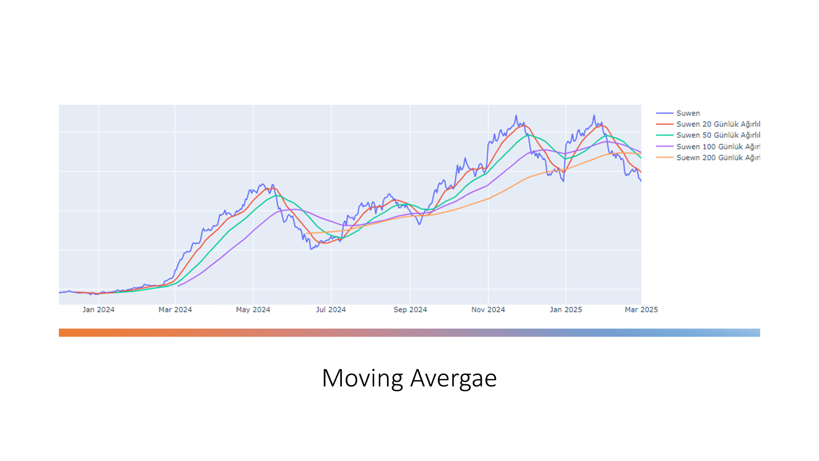

Slide 29
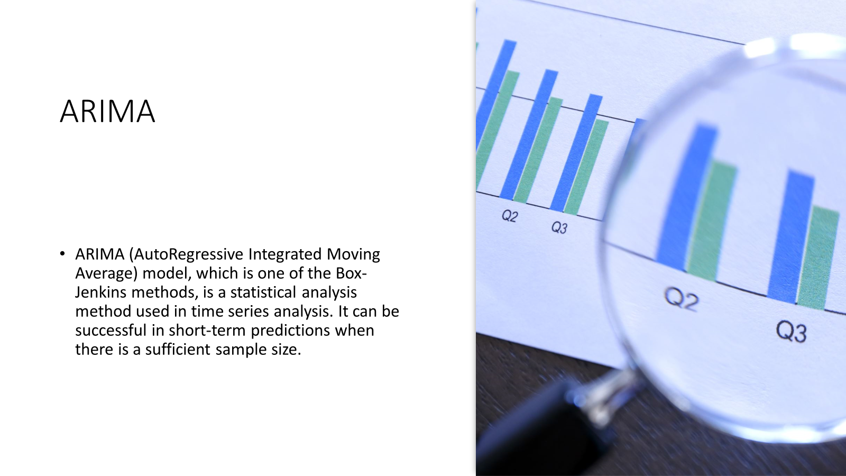

Slide 30
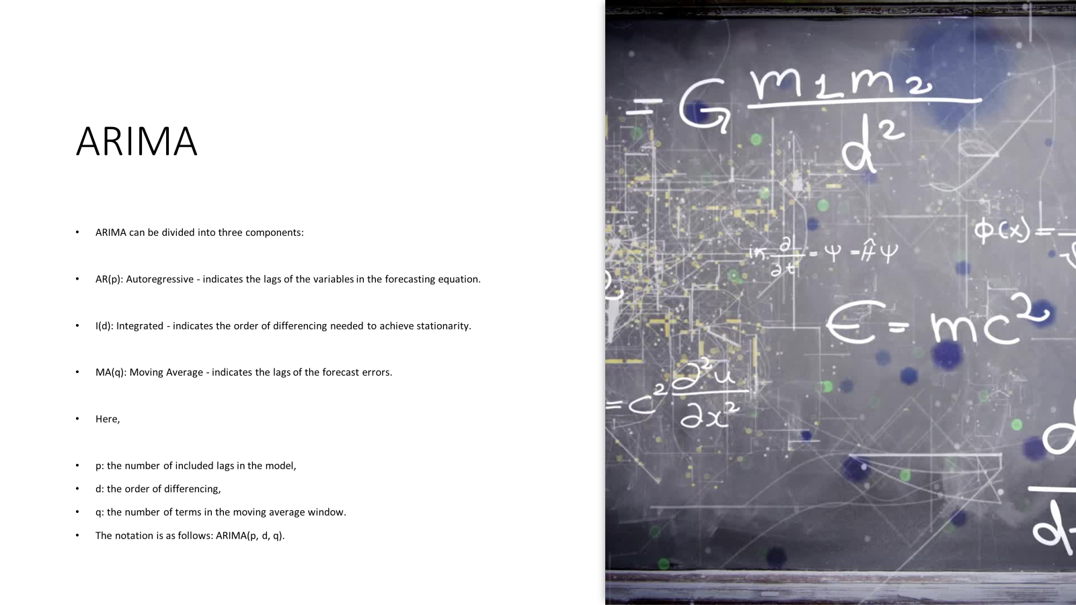

Slide 31
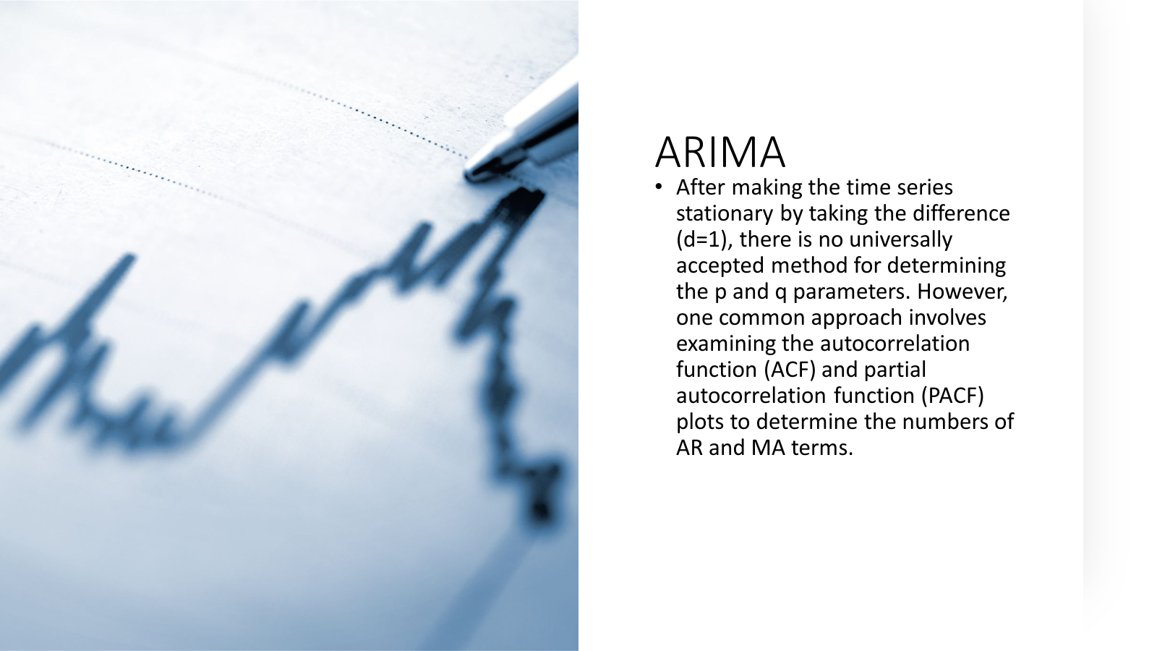

Slide 32
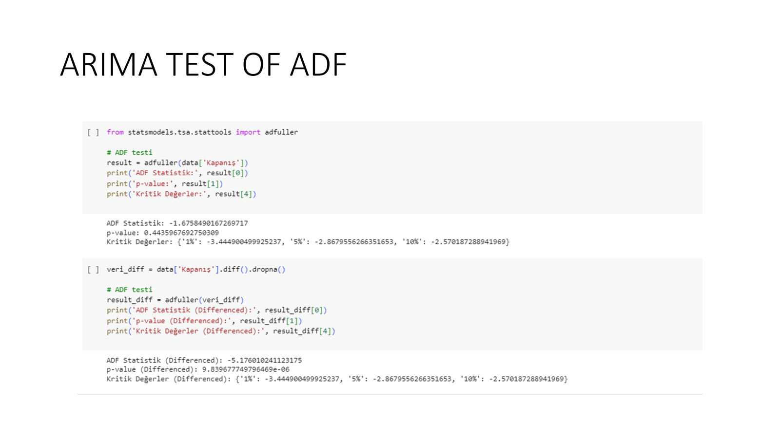

Slide 33
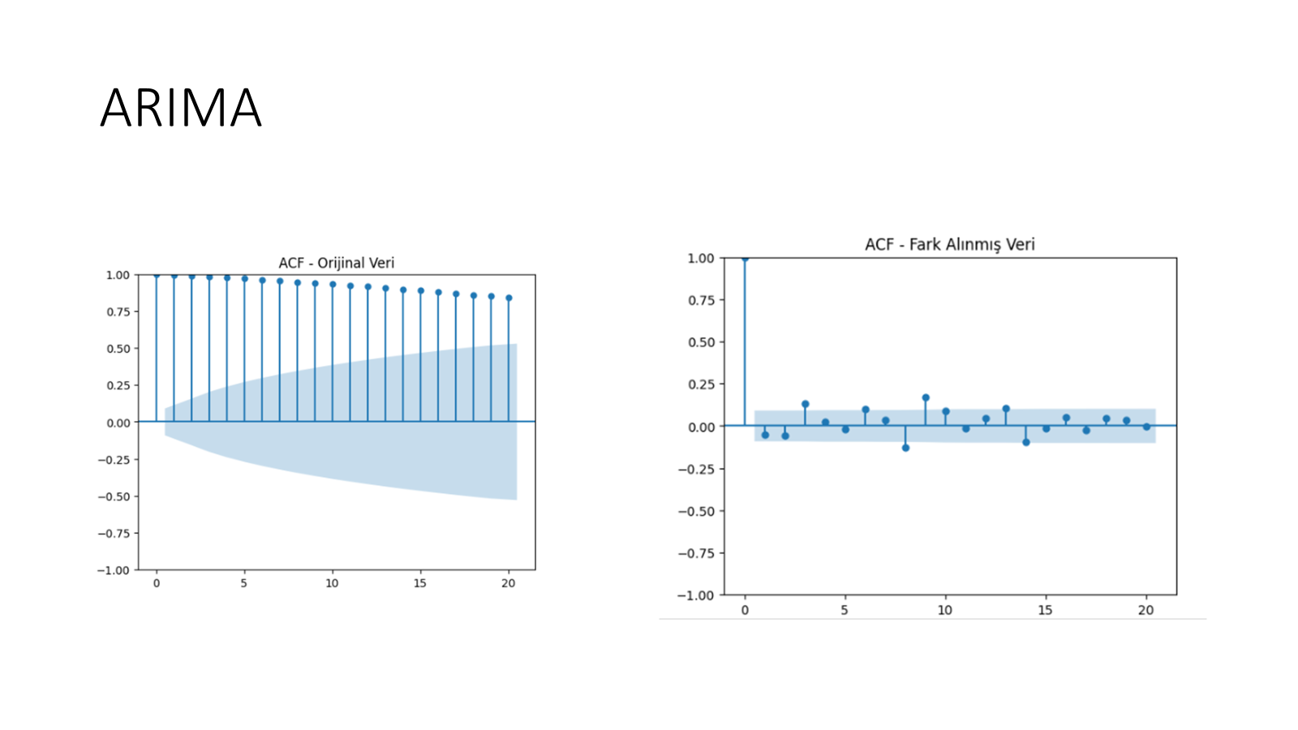

Slide 34
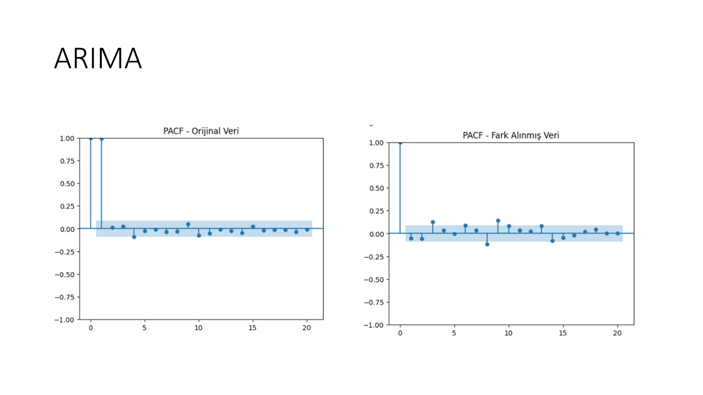

Slide 35
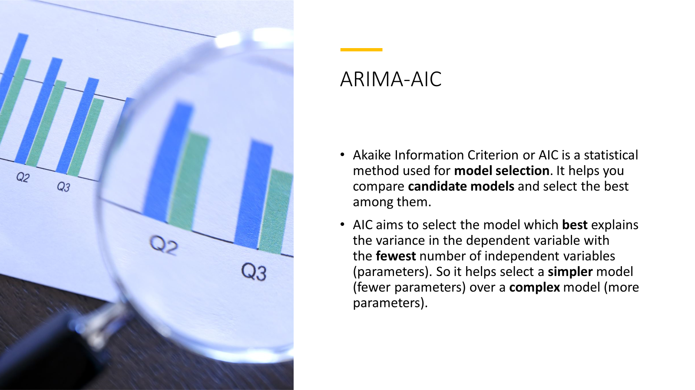

Slide 36
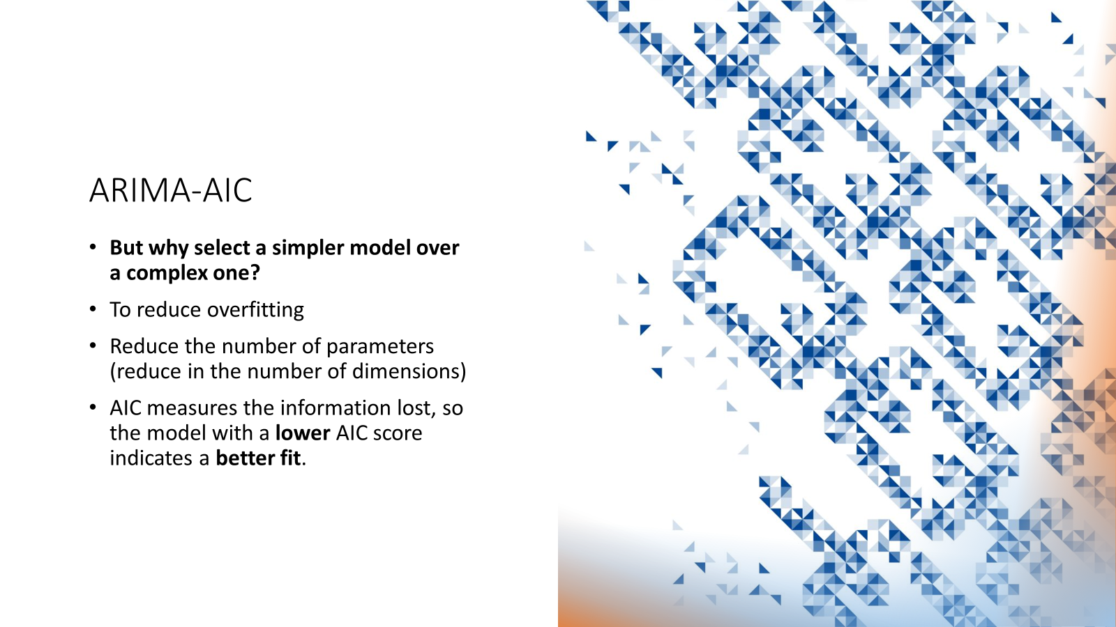

Slide 37
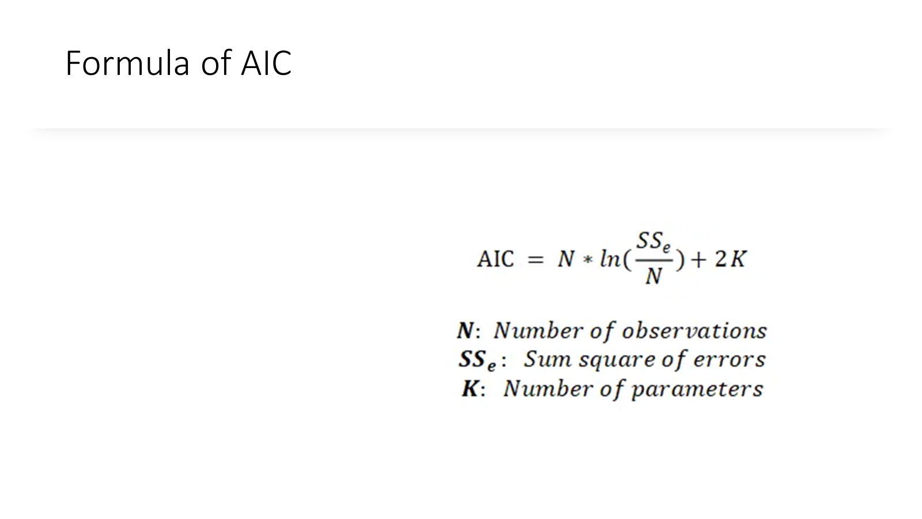

Slide 38
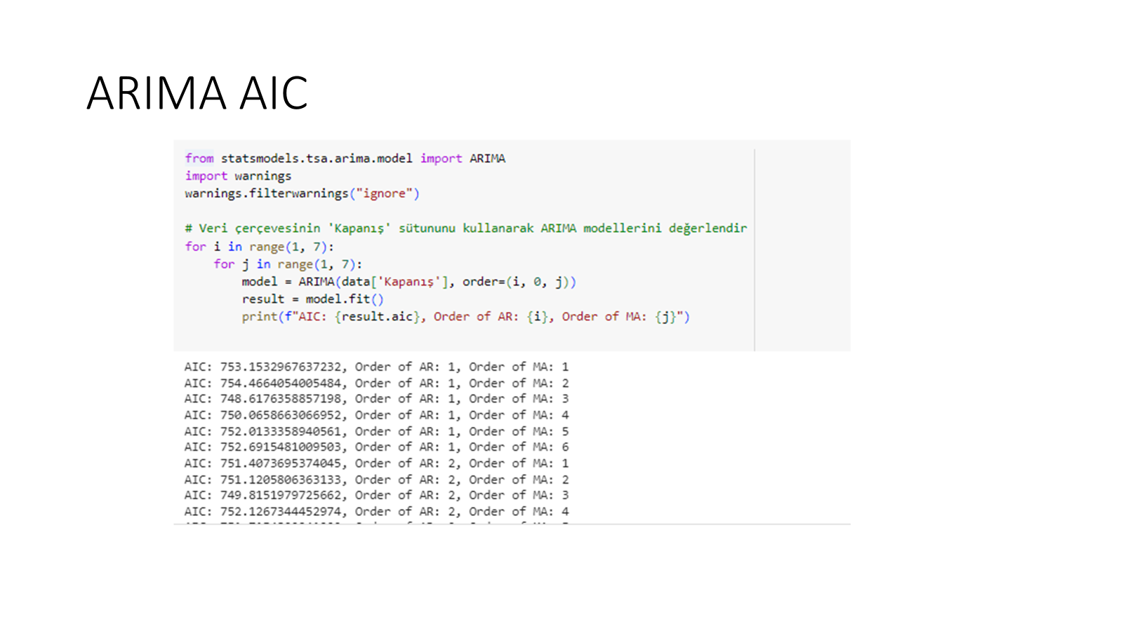

Slide 39
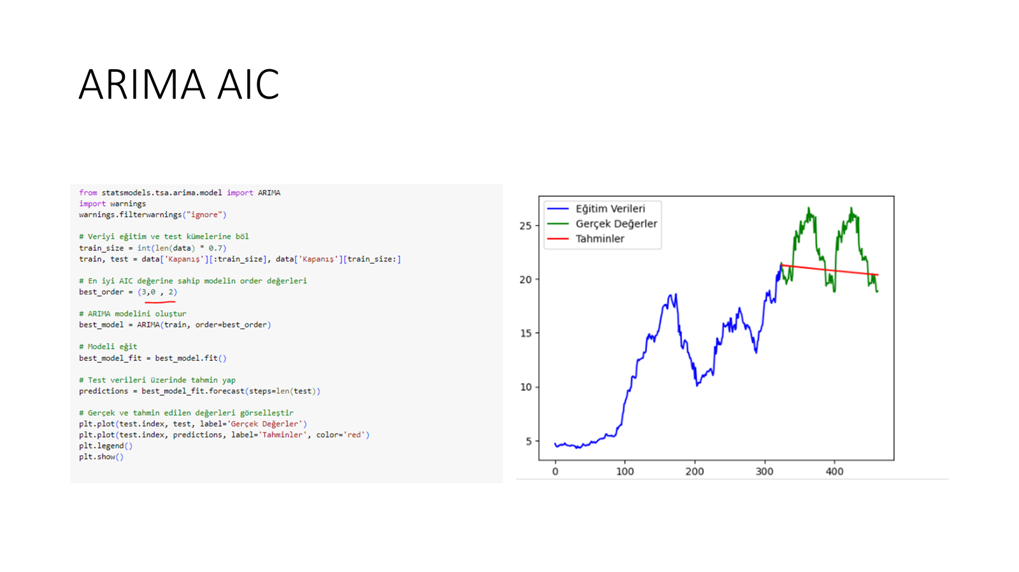

Slide 40


